Slide 1
Saying Goodbye to_____
ADD PICTURE BELOW

Slide 2
________ lived with us at our __________ home. He was a very special person and he loved ________.
ADD PICTURE BELOW

Slide 3
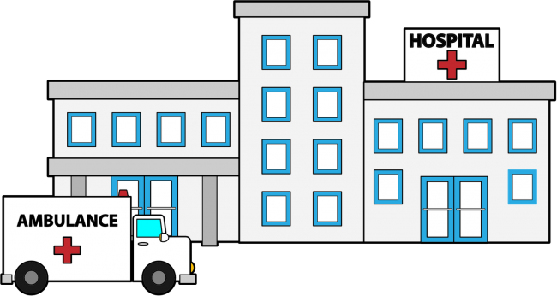
_________ was feeling unwell and went to the hospital on _________________.

Slide 4
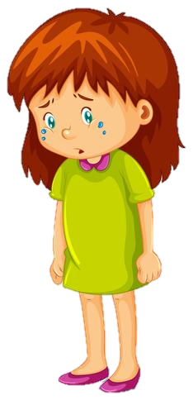
__________ died in the hospital and I will never get to see him again. This makes me feel sad, angry and confused

Slide 5
I will remember __________ being happy at home.
ADD PICTURE BELOW

Slide 6
I will miss spending time with _____________.

Slide 7
I will miss fun activities with ______________.

Slide 8
This may make me feel different emotions and I will need help from my staff at _______________.

Slide 9
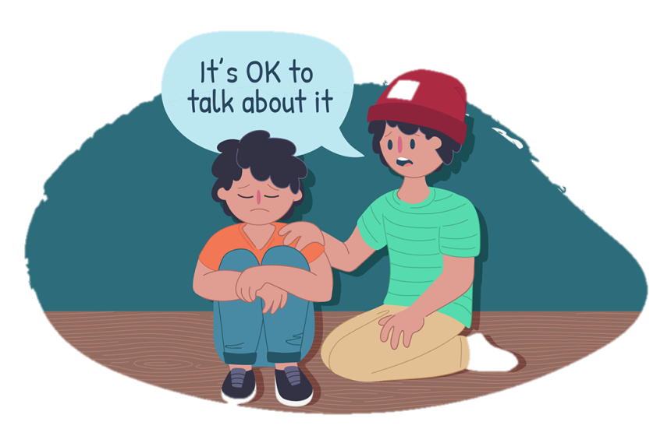
Staff can help me when I’m feeling these emotions by;
Talking with me
Listening to me

Slide 10
We can still miss ______ and remember all the fun we had together, by looking at pictures. My staff are here to support me during this time.
ADD PICTURE BELOW
(e.g., collage of memories)

