Slide 1
An Introduction to Supporting Social Skill Development in Young Children
Notes:
Welcome to this introductory learning module on Supporting Social Skill Development in Young Children, brought to you by the Every Child Belongs Team.
In this module you will learn why social skills are important, the foundations of social skill development and the first steps in supporting that development.

Slide 2
Research shows that a strong social and emotional foundation in early childhood powerfully impacts a child’s learning, health, positive attitudes and behaviours
Notes:
As social beings we enjoy interactions with others. Learning social rules and interpreting cues is no easy task for a young child. They are usually learned by trial and error with lots of tears along the way.
Research shows that a strong social and emotional foundation in early childhood powerfully impacts a child’s learning, health, positive attitudes and behaviours.
It’s no secret that children learn through communication and play. Learning to play with others is an important step along the road to building good relationships.

Slide 3
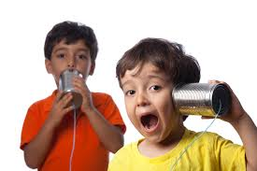
What are Social Skills?
Skills that we use every day to interact and communicate with others, verbally and non-verbally
Notes:
What are Social Skills?
These are skills that children and adults use everyday to interact and communicate with others verbally and non-verbally.
This includes gestures, facial expression and body language alone or combined with spoken words.
Some examples include asking another child, "can I play?", listening to others, making eye contact and waving to another person.
Social Skills are important because they help us to build and maintain relationships with others. Social skills provide us with experience on how to join or make connections with people, even when they do not speak the same language or when we communicate in different ways.

Slide 4
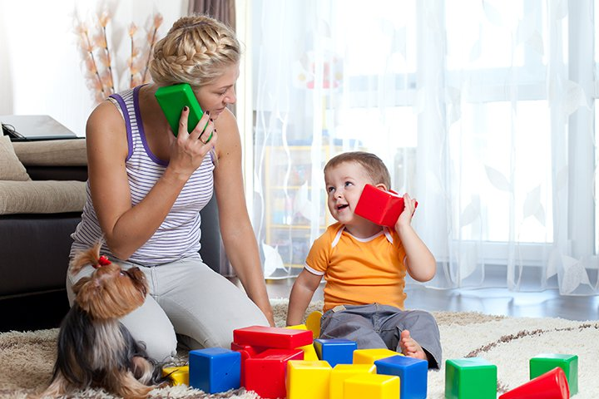
Why is communication so important?
Exchange of Information
Sharing Ideas and Thoughts
Expressing Feelings
Expressing Needs and Wants
Listening to and Understanding Others
Notes:
Communication, being understood and understanding others, is a key to developing good social skills.
Communication helps us:
Exchange information
Share ideas and thoughts
Express feelings
Express needs, wants and preferences
Listen to and understand others
Helping children to build their communication skills may help build social skills in three foundational areas.

Slide 5
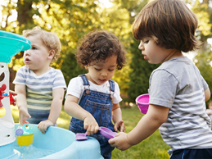
What are the foundations of social skills?
Social interactions
Emotional literacy
Self-regulation
Notes:
What are the foundations of social skills?
The foundations include:
social interactions
emotional literacy
self-regulation

Slide 6
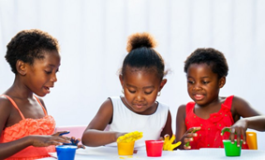
Social interactions
Social interactions are how we act and react with others around us, including adults and peers. This forms the basis of relationships with others.
Notes:
Social interactions are how we act and react with others around us, including adults and peers. This forms the basis of relationships with others. The back and forth nature of play sets the stage for good communication skills.

Slide 7
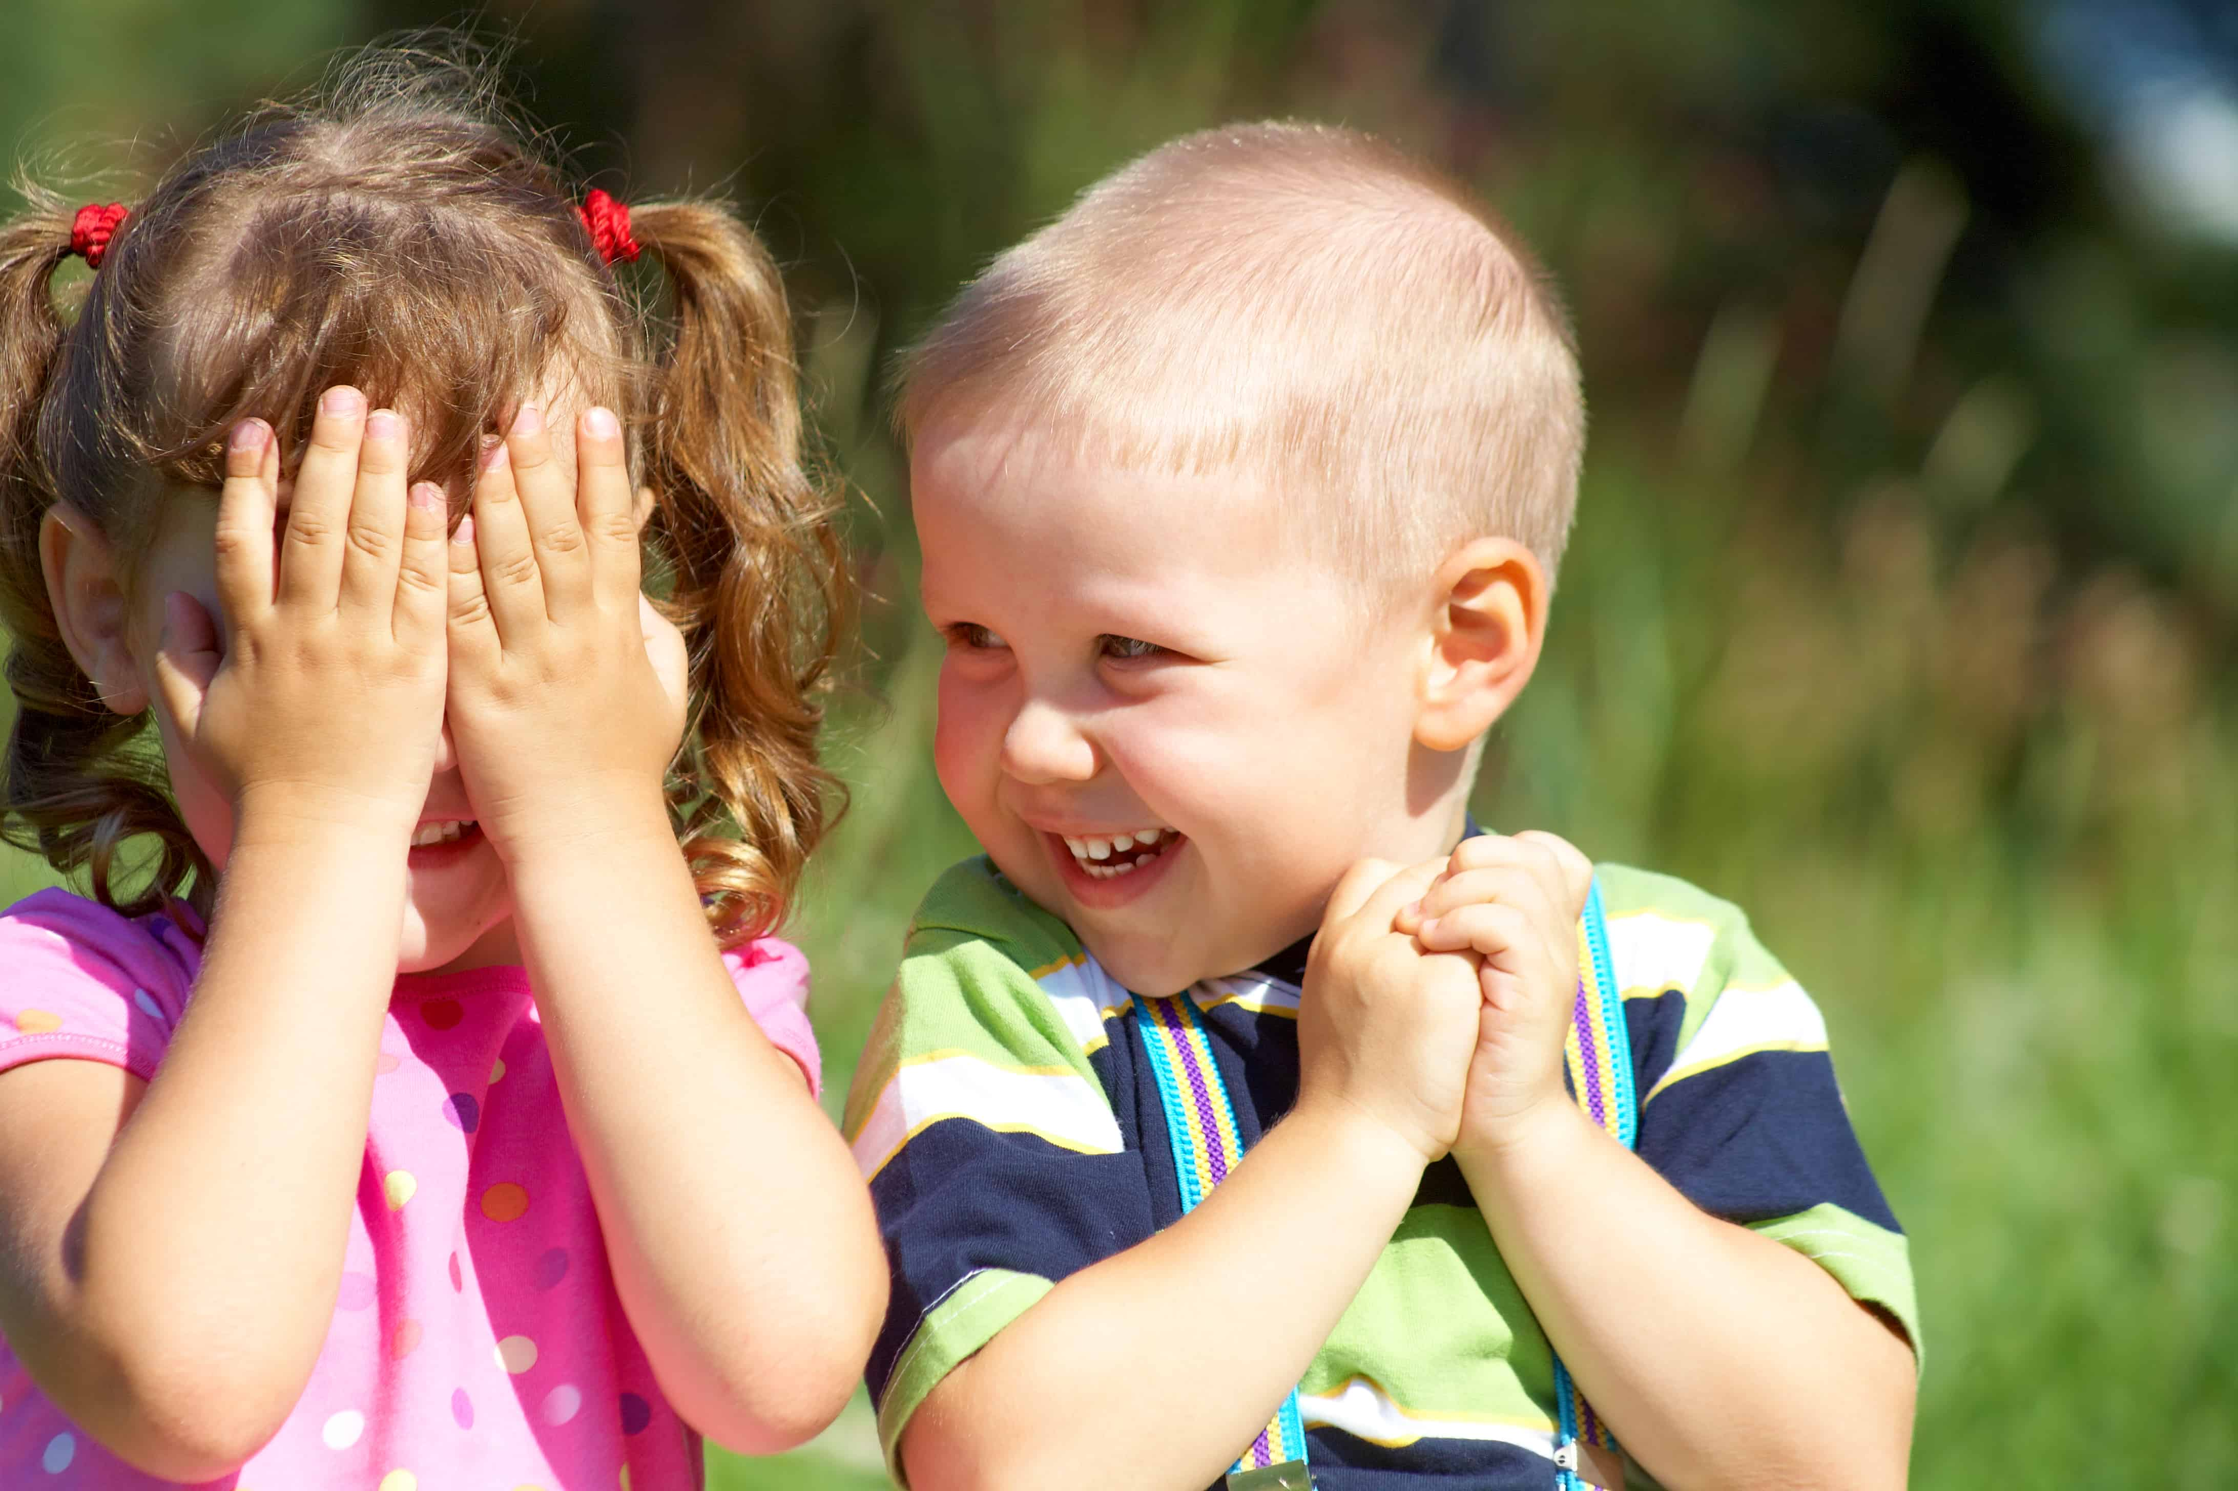
Social interactions
Share
Take turns
Cooperate
Listen
Play together
Problem solve
Manage conflicts
Understand personal space
Notes:
As children develop socially they can learn to share, take turns, cooperate, listen, play together, problem solve, manage conflicts and understand about personal space. These are all part of social learning.

Slide 8
Emotional literacy
Emotional Literacy is one’s ability to recognize, understand, label and express feelings. This also includes the ability to identify others’ emotions expressed through spoken language, body language and facial expressions.
Nurturing Emotional Literacy helps children learn:
Self awareness
Self management
Social awareness
Notes:
Emotional Literacy is one’s ability to recognize, understand, label and express feelings. This includes the ability to identify emotions expressed by others through spoken language, body language and facial expressions.
Nurturing Emotional Literacy helps children learn self awareness, self management and social awareness.
Self awareness includes recognizing thoughts, feelings, likes and dislikes, and understanding internal emotional states.
Self management includes such things as control over feelings, emotions and impulses, reacting in acceptable ways and using strategies to help keep calm and regulated.
Social Awareness is the understanding of our connection with others including social expectations, interactions and decisions.

Slide 9
Self regulation
Self-regulation is our ability to manage and control our own attention, energy levels, and emotions in ways that help us build positive relationships and a sense of wellbeing.
States of regulation
Under-stimulated –disappointed, sad, sick, lethargic, tired, bored
Regulated –calm, happy, tolerant, interactive, content, co-operative
Heightened –annoyed, irritated, overwhelmed, frustrated, anxious
Loss of control –enraged, terrified, destructive, aggressive, overly excited
Notes:
Self-regulation is our ability to manage and control our own attention, energy levels, and emotions in ways that help us build positive relationships and a sense of wellbeing. Learning to calm down when angry or excited, persisting at difficult tasks are examples of self-regulation.
States of regulation include 4 areas:
Under-stimulated – for example, disappointed, sad, sick, lethargic, tired, bored
Regulated –for example, calm, happy, tolerant, interactive, content, co-operative
Heightened –for example, annoyed, irritated, overwhelmed, frustrated, anxious
Loss of control – for example, enraged, terrified, destructive, aggressive, overly excited

Slide 10
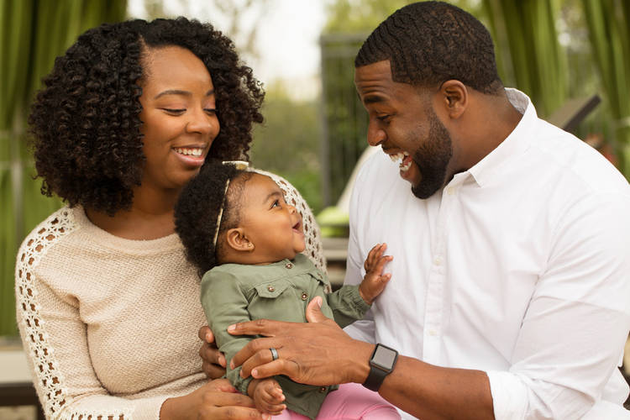
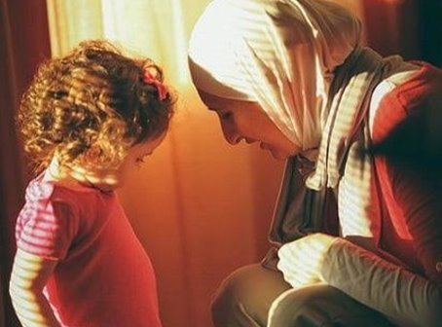
Self regulation
External regulation
Co-regulation
Notes:
As the beginnings of self-regulation are still developing in young children, infants are not able to regulate on their own. They rely on responsive parenting to help them regulate. From birth, we watch and listen to our infant children for clues as to their emotional state (For example, frightened, happy and angry). By responding to our child’s needs, a trusting relationship is built.
Co-regulation is a tool in supporting children to learn self-regulation skills. Modelling how to control and express our own feelings and actions appropriately helps children to learn how to identify their own needs and when to look for help. The development of self-regulation relies on a strong foundation of supportive relationships.
When children can self-regulate, they are able to navigate through challenges and make productive choices. Knowing how to self-regulate is an important skill that supports their physical, emotional, and social wellbeing.

Slide 11
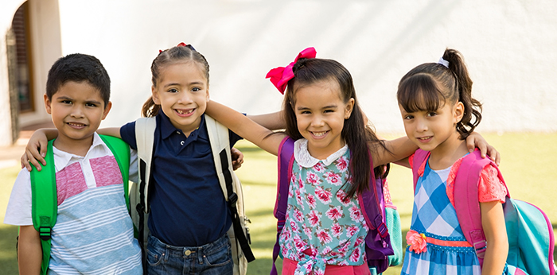
How Do Children Learn Social Skills?
Day-to-day experiences
Play is their work
Safe, nurturing environments
Notes:
How do children learn social skills?
Children are diligently learning and developing those important skills by day-to-day experiences. They learn a great deal from watching others, trying new experiences and repetition.
Children’s play is their work! That’s how they prepare themselves to be part of the social group. Play gives them the opportunity to problem solve, make choices and practice, as they experience trials, errors and successes.
Children learn best in environments where they feel safe and nurtured. Being welcomed and surrounded by nurturing, positive and capable adults gives children the confidence to explore, experiment and experience.
To help children to learn skills, you will have to consistently provide them opportunity to experience little successes through day to day experience,
For example, encourage them to clean up their mess. At first it may become a huge battle for you and you may have to help them by breaking down steps or providing hand over hand support , but if you keep it consistent, it will get better and the cleanup can be embedded into their routine after playing with toys.

Slide 12
Awareness of children’s unique backgrounds, experiences, and abilities
Each child comes with a unique set of experiences, abilities, interests and learning styles
Each child comes from diverse family and community backgrounds, rich in culture and language
Notes:
It’s important to remember that each child comes with a unique set of experiences, abilities, interests and learning styles
Each child comes from diverse family and community backgrounds, rich in culture and language
When deciding on the best approach for a child and family, keep this in mind and encourage parents to share their family’s culture as well as approaches that work well at home.

Slide 13
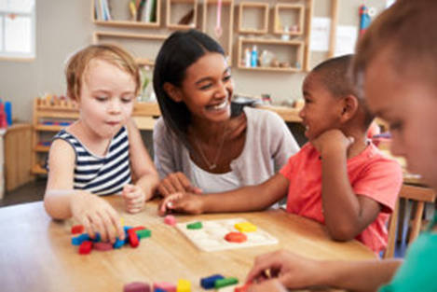
Working together
Get to know each other
Share ideas and resources
Work as a team to teach the same skill at the same time
Notes:
Families are our greatest resource, as we can get to know the child better this will help to build strengths in you and broaden the
experiences for all
To help with learning, it’s important for the social skill to be taught in different locations and with various people.
Get to know each other. Set aside time to meet and talk.
Share ideas and resources.
Work as a team. Try working together on one social skill at a time, getting everyone involved. Using the same approach will help to build success.

Slide 14
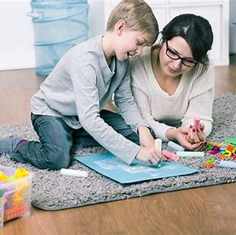
What are the first steps when helping children learn social skills?
Consider their current skills
Give positive messages
Be a positive role model
Set up your environment for success
Respect their comfort level
Focus on having fun!
Notes:
What are the first steps when helping children learn social skills?
Start by consider their current skills, abilities and interests. Ask yourself, “Will this skill improve their ability to communicate and socialize?”
Whatever the child’s skill level, give positive messages through smiles and encouragement. Praise them for their efforts in trying something new.
Be a positive role model Children learn by watching and practising what adults and other children do.
Set up the environment for success by…
Having a routine
Providing choices
Setting up activities that help practice social skills
Providing opportunities for children to play together
Encouraging pretend and role-play
When helping children make friends, follow their lead and respect their comfort level. Taking things slowly and focusing on fun are more likely to lead to success in the long run.
By focusing on developing social skills and using ideas and strategies to help them learn you will make a great contribution to a young life.

Slide 15
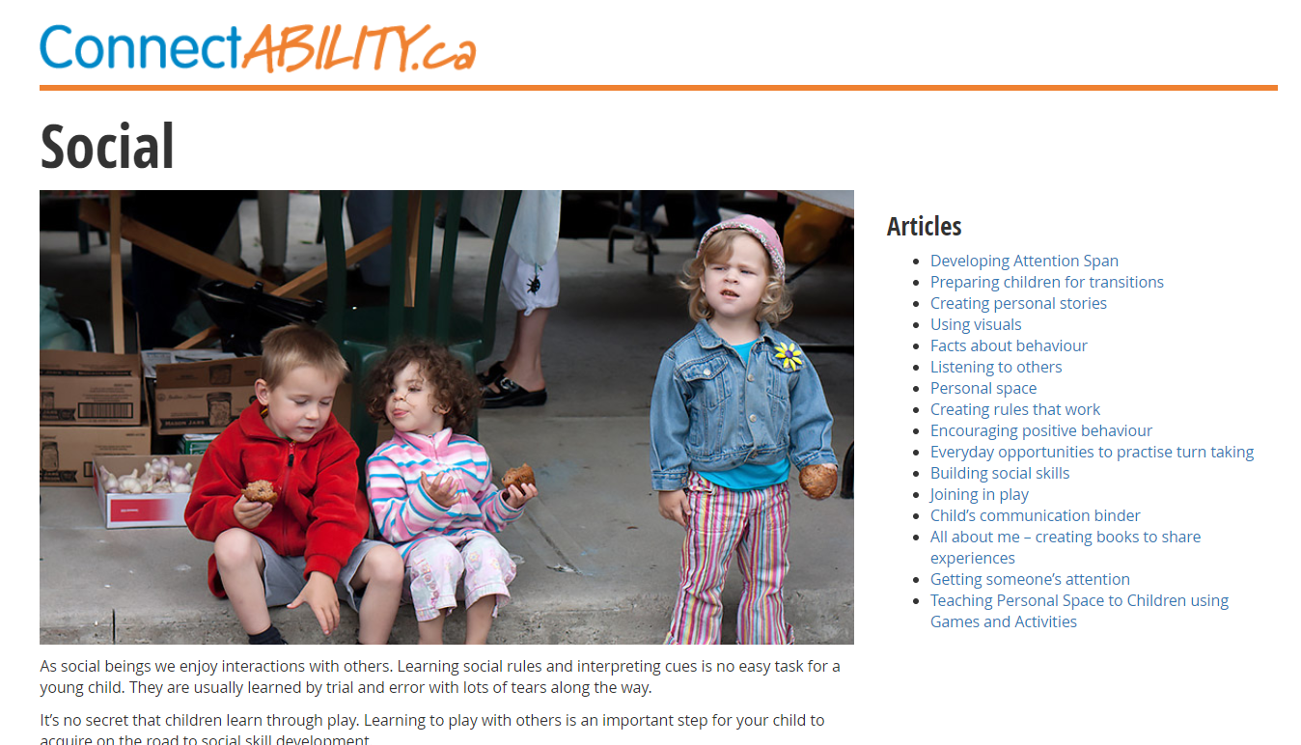
Ready to learn more?
https://connectability.ca/2014/06/14/social/
Notes:
Ready to dig deeper and learn more?
Check out this articles, presentations and resources in our Social page.
https://connectability.ca/2014/06/14/social/

Slide 16
Other ConnectABILITY links:
https://connectability.ca/2014/06/14/communication/
https://connectability.ca/2021/01/05/emotional-literacy-in-children/
https://connectability.ca/2021/01/05/understanding-self-regulation-in-young-children/
https://connectability.ca/2010/09/23/building-social-skills/
https://connectability.ca/2010/10/29/using-the-school-age-social-skills-program-kit/

Slide 17
References:
Barrett, P., Building Resilience, Fun Friends Program, Pathways Health and Research Centre, www.pathwayshrc.com.au
Developmentally Appropriate Practices for PK-12 Teachers, Preschool Tips: Social Emotional Development
https://sites.google.com/site/dapforteachers/home/preschool-tips-social-emotional-development
Robert Wood Johnson Foundation, Social Emotional Learning
https://www.rwjf.org/en/library/collections/social-and-emotional-learning.html
WBFO Buffalo, Preschool program zeros in on social emotional behavior
https://news.wbfo.org/post/preschool-program-zeroes-social-emotional-behavior

