Slide 1
SUICIDE & SUICIDAL IDEATION IN PEOPLE WITH INTELLECTUAL & DEVELOPMENTAL DISABILITIES/DUAL DIAGNOSIS (ID/DD)
Michelle Anbar-Goldstein, MSW, RSW Forensic Social Worker, CAMH Shared Learning Forum Virtual Presentation Friday, November 25, 2021 9:30AM – 11AM

Slide 2
A MESSAGE OF COMPASSION
Some of you might be survivors of suicide, may be struggling with thoughts of suicide and/or a history of suicidal ideation, or you may have a loved one who has or is struggling in this way
You may find that this information triggers you and/or heightens your emotions
If you or a loved one is struggling with suicide, there is help available
Should you require assistance navigating the resources available in your community, please do not hesitate to reach out to me
If available to you, I encourage you to reach out to Human Resources at your placement of work to learn more about the EAP at your agency
If you are finding this training stressful, I encourage you to take a break, but I just ask that you find support while you do so, and to let me know that you are okay.
Remember: mental health IS health. You are loved and supported, regardless of what afflicts you.

Slide 3
AGENDA
A note about nomenclature
Who am I and how did I get here?
Introductory conversation
Suicide in Canada
High Risk Populations
Suicide and IDD/DD
Tips for Intervening with an At-Risk Individual
Supports in the community
Steps moving forward

Slide 4
A NOTE ON NOMENCLATURE
INSTEAD OF USING:
INSTEAD OF USING:
USE:
USE:
INSTEAD OF USING:
USE:
Commit/ted suicide
Completed/successful suicide
Failed suicide attempt
Died by suicide/suicided
Death by suicide
Non-fatal suicide attempt
COMMIT/TED SUICIDE: CRIMINAL OVERTONES (IT WAS ILLEGAL TO KILL ONESELF); EQUATES SUICIDE TO RAPE/MURDER
COMPLETED/SUCCESSFULLY/FAILED: PARADOXICALLY USE A POSITIVE SLANT WHEN A SUICIDE IS CARRIED THROUGH, AND A NEGATIVE SLANT WHEN A SUICIDE IS ATTEMPTED BUT DOES NOT RESULT IN DEATH

Slide 5
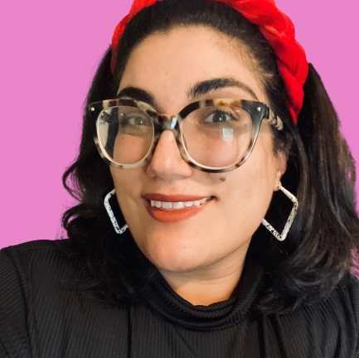
MICHELLE ANBAR-GOLDSTEIN, MSW, RSW
Advocate, educator & social worker with 15years of experience with the DS Sector
Forensic Dual Diagnosis Specialty Service at CAMH
Developmental Services Worker Program at Humber College
Internal Review Committee with Community Living Toronto & Clinical Case Conference (CNSC)
Instructor for LivingWork’s Applied Suicide Interventional Skills (ASIST) Training
Consultation, clinical work (individual & group)
Facilitation & design of workshops, groups and psycho-educational programs for people with ID/DD and the teams that support them throughout the DS and Mental Health sectors

Slide 6
What brought me to teaching about suicide and suicide first aid?
Notes:
Discuss the importance of directly and confidently addressing suicide

Slide 7
Why are you here today and what are you hoping to learn?
Have you been certified in Applied Suicide Intervention Skills Training?
STARTING OFF OUR CONVERSATION…
A REMINDER: Given the nature of the topic we are discussing today, sensitive information will likely arise. Please be respectful of those who share today, and keep their information and stories private.

Slide 8
2020
38.01 Million (2020)
4000 deaths/year
4200-5000 deaths/year (between 5%-25%)
Between 160 000 – 400 000 (40-100x greater than the number suicides)
4 180 000 people (11% of the population)
Imagery/slide taken from LivingWorks Canada’s ASIST Training (2019); Statistics published by the Government of Canada www.statcan.gc.ca (2020)

Slide 9
(https://www.canada.ca/en/public-health/services/publications/healthy-living/suicide-canada-key-statistics-infographic.html)

Slide 10
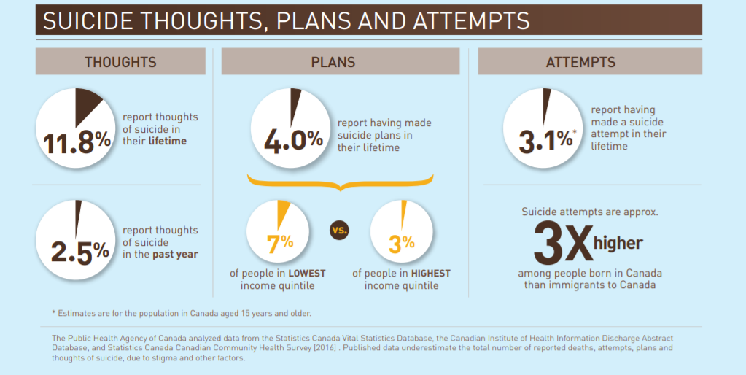
(https://www.canada.ca/en/public-health/services/publications/healthy-living/suicide-canada-key-statistics-infographic.html)

Slide 11
HIGHER-RISK POPULATIONS
In Canada, the following groups have higher rates or risk of suicide:
Men and boys
People serving federal sentences
Survivors of suicide loss and survivors of a suicide attempt
Some First Nation and Métis communities, especially among youth
All Inuit regions in Canada
Women have higher rates of self-harm. Self-harm can be a risk factor for suicide.
Thoughts of suicide and suicide-related behaviours are more frequent among LGBTQ youth in comparison to their non-LGBTQ peers
(https://www.canada.ca/en/public-health/services/publications/healthy-living/suicide-canada-key-statistics-infographic.html)
Notes:
- While it is good to know who is more likely to be suicidal, it is imperative that you don’t JUST focus on these groups, b/c you run the risk of ignoring other follks who may also need your help and/or attention

Slide 12
GAPS IN RESEARCH
Little data available on suicide among persons with ID/DD
General gaps in knowledge for people with IDD/DD
High prevalence of suicide risk factors among persons with ID
Depression rates substantially higher, little attention in research/literature around suicide
Suicidal ideation and gestures are underreported in this population
Patja et al.: Finnish study found out that the reported rates are 1/3 that of the general population

Slide 13
MENTAL HEALTH & ID/DD
Walters et al.: Subjects ages 18 to 21 (US) with ID, suicidality was associated with family discord, bereavement, and a history of physical or sexual abuse, risk factors associated with having an IDD/DD
Most of the studies described a life event (family member death, abuse, rejection), dual diagnosis or depression as important risk factors
People with IDD/DD share some risk factors for depression with the general population:
Abusive experiences, poor social support, unemployment and social disadvantage have all been linked to increased depressive symptoms (Ailey, 2008)
Females with IDD seem to experience higher rates of depression and anxiety compared to males with IDD, which is similar to the reported rates among people without disabilities (Hsieh, Scott & Murthy, 2020, p.50)

Slide 14
MENTAL HEALTH & IDD/DD Hsieh, Scott & Murthy, 2020
At least as likely, if not more likely, than the general population to develop depression and anxiety disorders, 2.2% to 15.8% and 3.8-17.4% of the population, respectively
Disparity to due to biological predisposition, increased exposure to adverse psychosocial experiences, and limited cognitive ability

Slide 15
PREVALENCE STUDIES Merrick, Merrick, Lunsky & Kandel, 2005
Study of adults with ID/DD (community/outpatient settings)
34% reported that “life was not worth living” sometimes
23% were thinking about killing themselves and
11% reported that they had attempted to kill themselves in the past (another sample of outpatient psychiatric subjects showed 6%), while an out-patient psychiatric sample from the US reported a finding of 6%.
It seems that suicidal behavior is common in persons with mild-moderate ID, while extremely rare in persons with severe-profound ID
Very difficult to diagnose depression in people with moderate to severe ID
Study of 98 adults with borderline-moderate ID (community/outpatient settings)
27% reported that they thought that life was not worth living “sometimes” (primarily mild vs. moderate/borderline)
8% reported while seven reported that they think this “most of the time” (majority mild)

Slide 16
“While there is a growing recognition that people with IDD need access to timely and effective mental health care, barriers to accessing services are still prevalent. One barrier to accessing care is that people with IDD are unlikely to self-refer for services, which necessitates that a caregiver must recognize and facilitate the referral process (Hsieh, Scott & Murthy, 2020, p.49).”

Slide 17
FUNDAMENTAL BELIEFS (about suicide first aid)
Most people at risk want to live & there are good reasons to be hopeful
Some persons at risk hide from view but most all really want to be seen and to talk about suicide
If a person is talking to you about suicide, some part of them wants to live, even if they are totally unaware of it
If given help, life will usually prevail over suicide
When offered in the context of an intervention, even something as seemingly small as wanting to have reasons for living can succeed against suicide

Slide 18
EXAMINE YOUR ATTITUDES
Our personal attitudes can affect how we intervene when someone is thinking of suicide
Recognize how feelings about and personal experiences with suicide might impact you in intervening with someone at risk
Identify beliefs that may assist you to be direct and comfortable in suicide situations
Identify beliefs that might help you to be flexible in meeting a person at risk’s need for guidance and care
Talk more openly about your attitudes toward suicide and life-assisting

Slide 20
How would you ask a person if they were thinking about suicide?

Slide 21
Sometimes, the kindest thing you can do, is ask directly & explicitly about suicide.
Asking a personal clearly and directly if they are thinking about suicide, is a way for you to demonstrate that you are comfortable hearing about it, and will not be scared off by their sadness & pain

Slide 22
Suicide is about loss & pain
A person telling their story provides them with a sense of relief from their pain
Hearing a person’s story creates the conditions for uncertainty/hope
This requires two tools:
1. Patience to listen
2. Persistence to help support the turn to safety

Slide 23
GROUP DISCUSSION: What are the next steps?

Slide 24
HELP IS AVAILABLE
9-1-1
Kids Help Phone: 1-800-668-6868
Text CONNECT to 686868
Chat Services [6 pm–2 am EST]: www.kidshelpphone.ca
Trans Lifeline: 1-877-330-6366
Hope for Wellness Help Line: 1-855-242-3310
Online chat: www.hopeforwellness.ca
Indian Residential Schools Crisis Line: 1-866-925-4419
Canada Suicide Prevention Service: 1-833-456-4566 [24/7]
For Quebec residents: [24/7] 1-866-APPELLE

Slide 25
QUESTIONS, COMMENTS?
THANK YOU!

Slide 26
WORKS CITED
Giannini, M. J., Bergmark, B., Kreshover, S., Elias, E., Plummer, C., & Okeefe, E. (2010). Understanding suicide and disability through three major disabling conditions: Intellectual disability, spinal cord injury, and multiple sclerosis. Disability and Health Journal,3(2), 74-78. doi:10.1016/j.dhjo.2009.09.001
Government of Canada (2020). Statistics Canada.
Hsieh, K., Scott, H. M., & Murthy, S. (2020). Associated Risk Factors for Depression and Anxiety in Adults With Intellectual and Developmental Disabilities: Five-Year Follow Up. American Journal on Intellectual and Developmental Disabilities,125(1), 49-63. doi:10.1352/1944-7558-125.1.49
LivingWorks Canada (2019). Applied Suicide Intervention Skills Training: Instructor’s Manual.
Merrick, J., Merrick, E., Lunsky, Y., & Kandel, I. (2005). Suicide Behavior in Persons with Intellectual Disability. The Scientific World JOURNAL,5, 729-735. doi:10.1100/tsw.2005.91

